Slide 1
C39FF: Finance and Financial Reporting
Financial Statements:
Introducing the core statements
(with Solutions)

Slide 2
The Main Financial Statements
1
Income Statement
2
Statement of Financial Position
3
Cash Flow Statement

Slide 3
Income Statement
Also known as the profit and loss account
Provides an insight into a company’s trading activities.
It compares the income generated from trading with the costs associated with earning that income, the difference being the profit or loss for the year.
Basic version:
Sales x
Expenses (y)
Profit/(loss) z

Slide 4
Statement of Financial Position
Also known as the balance sheet
Effectively, the statement consists of two lists:
(1) a list of everything owned by the business at the year end (assets)
(2) a list of the various sources of finance used to fund these acquisitions (liabilities & equity)
This statement always balances thanks to the dual aspect convention

Slide 5
Cash Flow Statement
More companies collapse because of lack of cash rather than poor profits
Profits are not the same as cash
Statement shows company’s cash inflows and outflows for year

Slide 6
Example - Jody
Jody set up in business selling cakes from a stall at Riccarton campus.
She bought 100 cakes from a wholesaler costing 50p each, paying cash from her own purse.
On her first day, she sold 80 cakes for £1 each

Slide 7
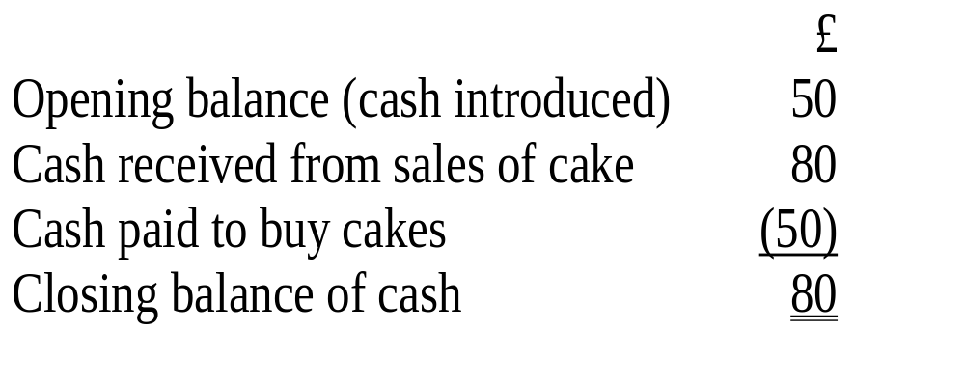
What cash movements took place?
Statement of cash flows

Slide 8
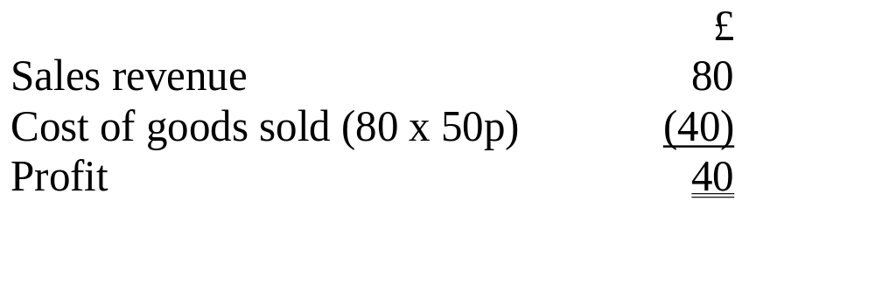
How much profit was generated?
Income statement

Slide 9
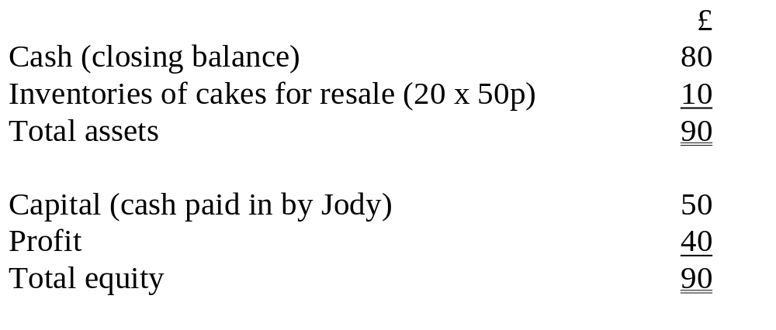
What is the accumulated wealth at the end of day 1?
Statement of financial position

Slide 10
Jody – Day 2
Next day, Jody bought 120 more cakes for £60, using the cash generated by her sales the previous day.
On day 2, Jody managed to sell 130 cakes for £1 each

Slide 11
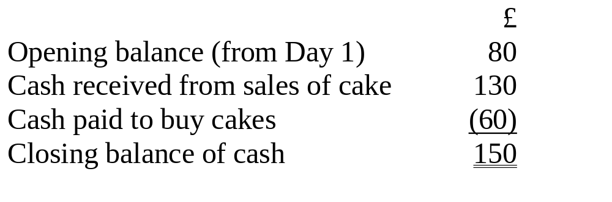
Day 2 results – Cash Flow
Statement of Cash Flows

Slide 12
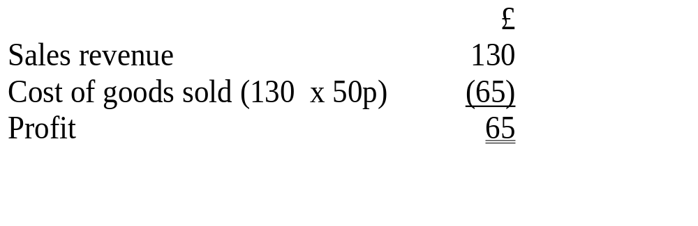
Day 2 results - Profit
Income statement

Slide 13
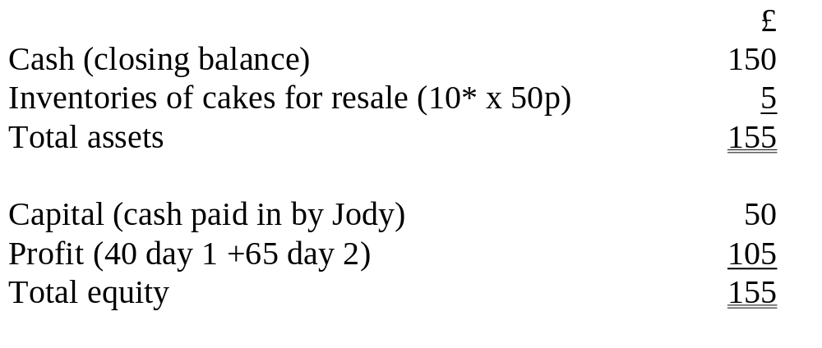
Day 2 results – Accumulated Wealth
Statement of financial position
* 20 cakes left over from day 1 + 120 cakes purchased – 130 cakes sold day 2

Slide 14
Cost of Sales
RETAIL
Opening inventories
+ Purchases
- Closing inventories
= Cost of sales
MANUFACTURING
Opening inventories
+ Raw materials
+ manufacturing wages
+ manufacturing expenses
closing inventories
= Cost of sales

Slide 15
Summary
The three core Financial Statements record:
  How cash flows through an organisation
  The amount of profit generated
  The accumulated wealth
Inventories (Stock) may need to be split into three categories:
  Raw materials
  Work in progress
  Finished Goods

